Slide 1
Data Center Infrastructure
CT109-3-2
Building Automation and Energy Management Systems I - Discussion
Prepared by: Dr.Arun First Prepared on: 01.12.17 Last Modified on: DD.MM.YY
Quality checked by:
Copyright 2012 Asia Pacific University of Technology and Innovation

Slide 2
BMS
BMS stands for?
A building management system (BMS), otherwise known as a building automation system (BAS)
BMS?
It is a computer-based control system installed in buildings that controls and monitors the building's mechanical and electrical equipment such as ventilation, lighting, power systems, fire systems, and security systems.
BMS Consists of ?
A BMS consists of software and hardware; the software program, usually configured in a hierarchical manner, can be proprietary, using such protocols as C-Bus, Profibus, and so on.

Slide 3
BMS
BMS produced by?
Vendors
Protocols used by BMS?
BMS integrates the use of Internet protocols and open standards such as DeviceNet, SOAP, XML, BACnet, LonWorks and Modbus.
Example BMS videos?
https://www.youtube.com/watch?v=xI6kst8XKu0
https://www.youtube.com/watch?v=Xgalj4wklPE

Slide 4
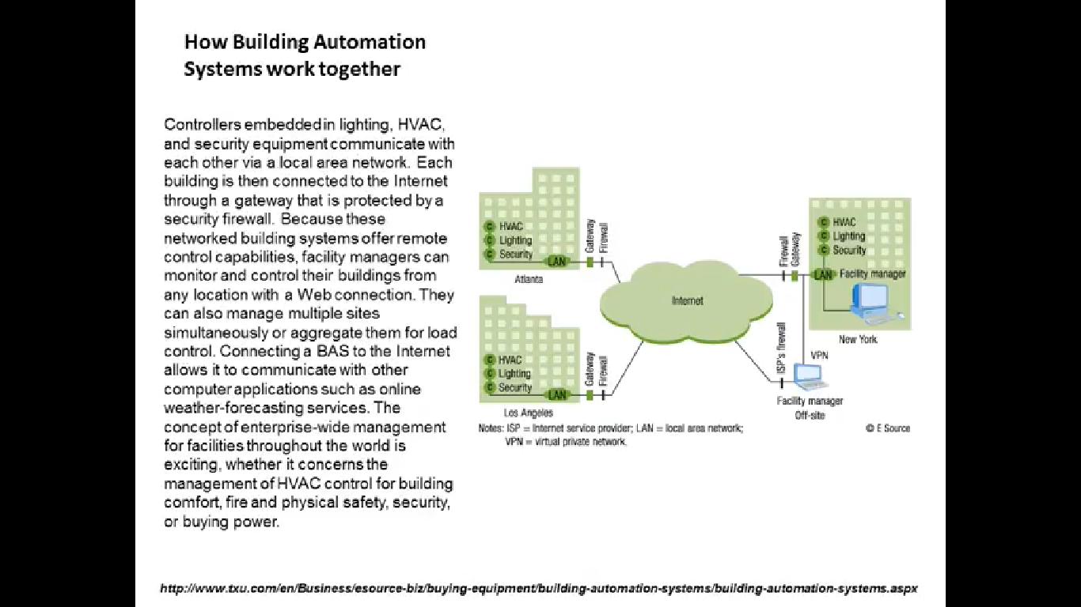

Slide 5
EMS
Energy management systems are also often commonly used by individual commercial entities to monitor, measure, and control their electrical building loads.
Energy management systems can be used to centrally control devices like HVAC units and lighting systems across multiple locations, such as retail, grocery and restaurant sites.
Energy management systems can also provide metering, submetering, and monitoring functions that allow facility and building managers to gather data and insight that allows them to make more informed decisions about energy activities across their sites.

Slide 6
EMS vs BMS
Energy Management Systems vs. Building Automation System
Energy management systems and building automation systems serve two very different functions.
Example - Perhaps the easiest way to understand the difference is to think of your building as a car. An energy management system is the dashboard of your car: it allows you to see all the controls and understand how all components are operating. With this high-level view, you accurately direct your car.
That’s when the building automation system comes in. BAS acts as the steering wheel: you can direct the car by telling it what to do. You can set it on “cruise” mode to drive on autopilot, but you’ll still need to run frequent, necessary checks to make sure everything is working properly.

Slide 7
EMS vs BMS
Your building operates the same way. A good energy management software provides an overview of your portfolio operations, with the option to explore a potential problem before it happens.
You then use this information to set your building automation system to run most efficiently.

Slide 8
EMS vs BMS
BMS | EMS
In BMS, Hardware Installation Required | In EMS,No Hardware Installation required
It is Cost Prohibitive | It is Cost effective
BMS automates the control of things like heat pumps, lighting systems, HVAC boxes, and all of this simplifies the jobs of chief engineers and building operators. | EMS provides advanced analytics and are the brains of the operation, taking in all the data and processing the information as they come.
It is not effectively optimize building management | It is effectively optimize building management
It does not track energy usage | It tracks energy usage

Slide 9
Where Do I Start?
If you don’t have either a BMS or an EMS in your building, you should start by installing web-enabled meters and monitoring meter data with an energy management system. Here’s why:
First, meters can be installed in any building and will get you started for a fraction of the cost of a building management system. Maybe you even already have meters that integrate with your EMS.
Second, you can get actionable data in under 30 days and get a return on your investment right away. After setting up meters and real-time energy management software, Cassidy Turley (now DTZ) identified $91,000 in annual energy cost savings in one of their buildings, thus justifying future investments in energy efficiency efforts.
Third, you can identify opportunities and justify capital investments (such as investing in a BMS).

Slide 10
Q&A

